Slide 1
A Tale of Two Cities
Clustering Neighborhoods of London and Paris using Machine Learning
By Jazib khan

Slide 2
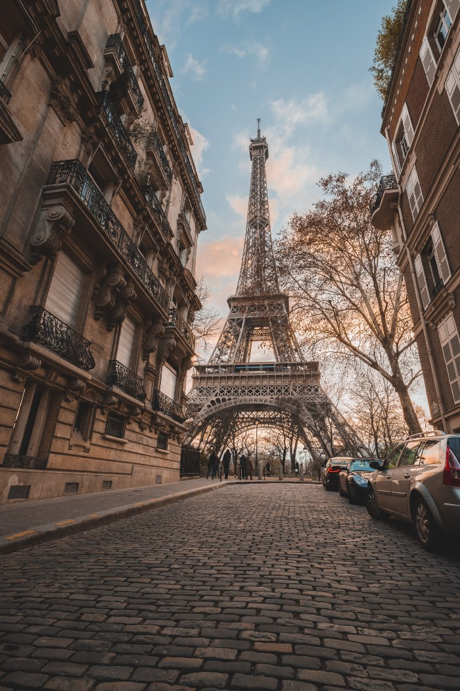

Slide 3
Introduction
A Tale of Two Cities, a novel written by Charles Dickens was set in London and Paris, which takes place during the French Revolution. These cities were both happening then and now. A lot has changed over the years, and we now take a look at how the cities have grown.
London and Paris are quite a popular tourist and vacation destinations for people all around the world. They are diverse and multicultural and offer a wide variety of experiences that are widely sought after. We try to group the neighbourhoods of London and Paris respectively and draw insights to what they look like now.

Slide 4
Business Problem
The aim is to help tourists choose their destinations depending on the experiences that the neighbourhoods have to offer and what they would want to have. This model also helps people make decisions if they are thinking about migrating to London or Paris or even if they wish to relocate neighbourhoods within the city. Our findings will help stakeholders make informed decisions and address any concerns they have, including the different kinds of cuisines, provision stores and what the city has to offer.

Slide 5
Data Description
We require geographical location data for both London and Paris. Postal codes in each city serve as a starting point. Using Postal codes, we can find out the neighbourhoods, boroughs, venues and their most popular venue categories.

Slide 6
London
To derive our solution, We scrape our data from https://en.wikipedia.org/wiki/List_of_areas_of_London
This Wikipedia page has information about all the neighbourhoods; we limit it to London.
borough: Name of Neighborhood
town: Name of the borough
post_code: Postal codes for London.
This Wikipedia page lacks information about geographical locations. To solve this problem, we use ArcGIS API.
ArcGIS API
ArcGIS Online enables you to connect people, locations, and data using interactive maps. Work with smart, data-driven styles and intuitive analysis tools that deliver location intelligence. Share your insights with the world or specific groups.
More specifically, we use ArcGIS to get the geographical locations of the neighbourhoods of London. Adding the following columns to our initial data set prepares our data.
latitude: Latitude for Neighborhood
longitude: Longitude for Neighborhood

Slide 7
Paris
To derive our solution, We leverage JSON data available at https://www.data.gouv.fr/fr/datasets/r/e88c6fda-1d09-42a0-a069-606d3259114e
The JSON file has data about all the neighbourhoods in France; we limit it to Paris.
postal_code: Postal codes for France
nom_comm: Name of Neighborhoods in France
nom_dept: Name of the boroughs, equivalent to towns in France
geo_point_2d: Tuple containing the latitude and longitude of the Neighborhoods.

Slide 8
Foursquare API Data
We will need data about different venues in different neighbourhoods of that specific borough. To gain that information, we will use “Foursquare” location information. Foursquare is a location data provider with information about all manner of venues and events within an area of interest. Such information includes venue names, locations, menus and even photos. As such, the foursquare location platform will be used as the sole data source since all the stated required information can be obtained through the API.
After finding the list of neighbourhoods, we then connect to the Foursquare API to gather information about venues inside each neighbourhood. For each neighbourhood, we have chosen the radius to be 500 meters.
The data retrieved from Foursquare contained information of venues within a specified distance of the longitude and latitude of the postcodes. The information obtained per venue as follows:

Slide 9
Neighbourhood: Name of the Neighborhood
Neighbourhood Latitude: Latitude of the Neighborhood
Neighbourhood Longitude: Longitude of the Neighborhood
Venue: Name of the Venue
Venue Latitude: Latitude of Venue
Venue Longitude: Longitude of Venue
Venue Category: Category of Venue

Slide 10
Based on all the information collected for both London and Paris, we have sufficient data to build our model. We cluster the neighbourhoods together based on similar venue categories. We then present our observations and findings. Using this data, our stakeholders can take the necessary decision.

Slide 11
Methodology
We will be creating our model with the help of Python, so we start by importing all the required packages. The code is available on GitHub to follow along.

Slide 12
import pandas as pd import requests import numpy as np import matplotlib.cm as cm import matplotlib.colors as colors import folium from sklearn.cluster import KMeans

Slide 13
Package breakdown:
Pandas: To collect and manipulate data in JSON and HTML and then data analysis
requests: Handle HTTP requests
matplotlib: Detailing the generated maps
folium: Generating maps of London and Paris
sklearn: To import K Means machine learning model.
The approach taken here is to explore each of the cities individually, plot the map to show the considered neighbourhoods and then build our model by clustering all of the similar neighbourhoods together and finally plot the new map with the clustered neighbourhoods. We draw insights and then compare and discuss our findings.

Slide 14
Data Collection
In the data collection stage, we begin with collecting the required data for the cities of London and Paris. We need data that has the postal codes, neighbourhoods and boroughs specific to each of the cities.
To collect data for London, using pandas, we scrape the List of areas of London Wikipedia page to take the 2nd table:

Slide 15
url_london = "https://en.wikipedia.org/wiki/List_of_areas_of_London" wiki_london_url = requests.get(url_london) wiki_london_data = pd.read_html(wiki_london_url.text) wiki_london_data = wiki_london_data[1] wiki_london_data

Slide 16
nom_comm: Name of Neighborhoods in France
nom_dept: Name of the boroughs, equivalent to towns in France
geo_point_2d: Tuple containing the latitude and longitude of the Neighborhoods.

Slide 17
Foursquare API Data
We will need data about different venues in different neighbourhoods of that specific borough. To gain that information, we will use “Foursquare” location information. Foursquare is a location data provider with information about all manner of venues and events within an area of interest. Such information includes venue names, locations, menus and even photos. As such, the foursquare location platform will be used as the sole data source since all the stated required information can be obtained through the API.
After finding the list of neighbourhoods, we then connect to the Foursquare API to gather information about venues inside each neighbourhood. For each neighbourhood, we have chosen the radius to be 500 meters.
The data retrieved from Foursquare contained information of venues within a specified distance of the longitude and latitude of the postcodes. The information obtained per venue are as follows:

Slide 18
Neighbourhood: Name of the Neighborhood
Neighbourhood Latitude: Latitude of the Neighborhood
Neighbourhood Longitude: Longitude of the Neighborhood
Venue: Name of the Venue
Venue Latitude: Latitude of Venue
Venue Longitude: Longitude of Venue
Venue Category: Category of Venue

Slide 19
Based on all the information collected for both London and Paris, we have sufficient data to build our model. We cluster the neighbourhoods together based on similar venue categories. We then present our observations and findings. Using this data, our stakeholders can take the necessary decision.

Slide 20
Methodology
We will be creating our model with the help of Python, so we start by importing all the required packages. The code is available on GitHub to follow along.

Slide 21
import pandas as pd import requests import numpy as np import matplotlib.cm as cm import matplotlib.colors as colors import folium from sklearn.cluster import KMeans

Slide 22
Package breakdown:
Pandas: To collect and manipulate data in JSON and HTML and then data analysis
requests: Handle HTTP requests
matplotlib: Detailing the generated maps
folium: Generating maps of London and Paris
sklearn: To import K Means machine learning model.
The approach taken here is to explore each of the cities individually, plot the map to show the neighbourhoods being considered and then build our model by clustering all of the similar neighbourhoods together and finally plot the new map with the clustered neighbourhoods. We draw insights and then compare and discuss our findings.

Slide 23
Data Collection
In the data collection stage, we begin with collecting the required data for the cities of London and Paris. We need data that has the postal codes, neighbourhoods and boroughs specific to each of the cities.
To collect data for London, using pandas, we scrape the List of areas of London Wikipedia page to take the 2nd table:

Slide 24
url_london = "https://en.wikipedia.org/wiki/List_of_areas_of_London" wiki_london_url = requests.get(url_london) wiki_london_data = pd.read_html(wiki_london_url.text) wiki_london_data = wiki_london_data[1] wiki_london_data

Slide 25
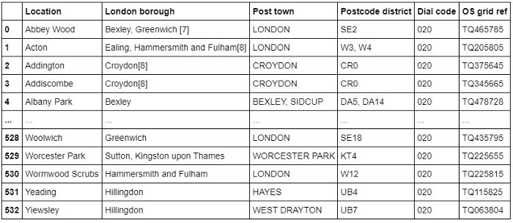
The data looks like this:

Slide 26
To collect data for Paris, we download the JSON file containing all the postal codes of France from https://www.data.gouv.fr/fr/datasets/r/e88c6fda-1d09-42a0-a069-606d3259114e
Using Pandas, we load the table after reading the JSON file:
!wget -q -O 'france-data.json' https://www.data.gouv.fr/fr/datasets/r/e88c6fda-1d09-42a0-a069-606d3259114e print("Data Downloaded!") paris_raw = pd.read_json('france-data.json') paris_raw.head()

Slide 27
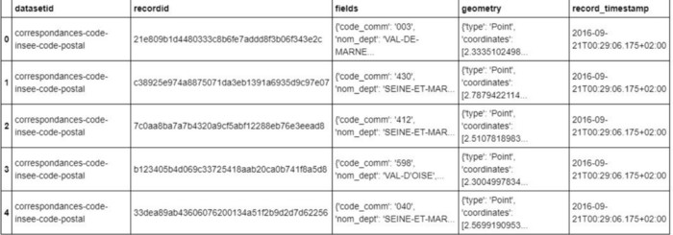
JSON data containing postal codes of France

Slide 28
Data Preprocessing
For London, We replace the spaces with underscores in the title. The borough column has numbers within square brackets that we remove using:

Slide 29
wiki_london_data.rename(columns=lambda x: x.strip().replace(" ", "_"), inplace=True) wiki_london_data['borough'] = wiki_london_data['borough'].map(lambda x: x.rstrip(']').rstrip('0123456789').rstrip('['))For Paris, we break down each of the nested fields and create the dataframe that we need:
paris_field_data = pd.DataFrame() for f in paris_raw.fields: dict_new = f paris_field_data = paris_field_data.append(dict_new, ignore_index=True) paris_field_data.head()

Slide 30
Feature Selection
For both of our datasets, we need only the borough, neighbourhood, postal codes and geolocations (latitude and longitude). So we end up selecting the columns that we need by:

Slide 31
df1 = wiki_london_data.drop( [ wiki_london_data.columns[0], wiki_london_data.columns[4], wiki_london_data.columns[5] ], axis=1) df_2 = paris_field_data[['postal_code','nom_comm','nom_dept','geo_point_2d']]

Slide 32
Feature Engineering
Both of our Datasets contain information related to all the cities in the country. We can narrow down and further process the data by selecting only the neighbourhoods of ‘London’ and ‘Paris’.
df1 = df1[df1['town'].str.contains('LONDON')] df_paris = df_2[df_2['nom_dept'].str.contains('PARIS')].reset_index(drop=True)Looking over our London dataset, we can see that we don’t have the geolocation data. We need to extrapolate the missing data for our neighbourhoods. We perform this by leveraging the ArcGIS API. With the Help of ArcGIS API we can get the latitude and longitude of our London neighbourhood data.
from arcgis.geocoding import geocode from arcgis.gis import GIS gis = GIS()

Slide 33
Defining London ArcGIS geocode function to return latitude and longitude.
def get_x_y_uk(address1): lat_coords = 0 lng_coords = 0 g = geocode(address='{}, London, England, GBR'.format(address1))[0] lng_coords = g['location']['x'] lat_coords = g['location']['y'] return str(lat_coords) +","+ str(lng_coords)

Slide 34
Passing postal codes of London to get the geographical coordinates
coordinates_latlng_uk = geo_coordinates_uk.apply(lambda x: get_x_y_uk(x))We proceed with Merging our source data with the geographical co-ordinates to make our dataset ready for the next stage
london_merged = pd.concat([df1,lat_uk.astype(float), lng_uk.astype(float)], axis=1) london_merged.columns= ['borough','town','post_code','latitude','longitude'] london_merged

Slide 35
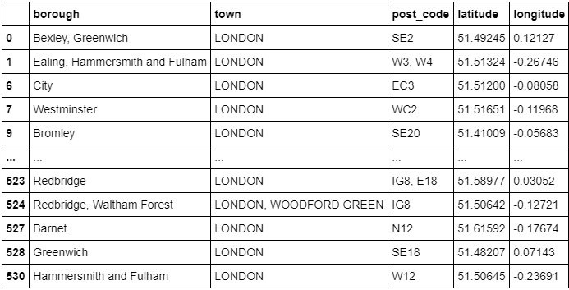

Slide 36
As for our Paris dataset, we don’t need to get the Geo coordinates using an external data source or collect it with the ArcGIS API call since we already have it stored in the geo_point_2d column as a tuple in the df_paris dataframe.
We just need to extract the latitude and longitude from the column:
paris_lat = paris_latlng.apply(lambda x: x.split(',')[0]) paris_lat = paris_lat.apply(lambda x: x.lstrip('[')) paris_lng = paris_latlng.apply(lambda x: x.split(',')[1]) paris_lng = paris_lng.apply(lambda x: x.rstrip(']')) paris_geo_lat = pd.DataFrame(paris_lat.astype(float)) paris_geo_lat.columns=['Latitude'] paris_geo_lng = pd.DataFrame(paris_lng.astype(float)) paris_geo_lng.columns=['Longitude']

Slide 37
We then create our Paris dataset with the required information:
paris_combined_data = pd.concat([df_paris.drop('geo_point_2d', axis=1), paris_geo_lat, paris_geo_lng], axis=1) paris_combined_data

Slide 38
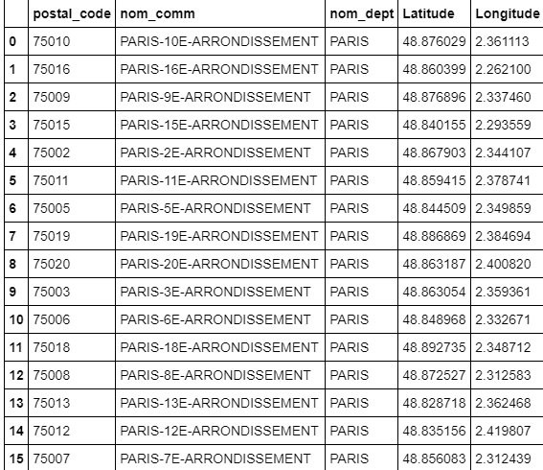

Slide 39
Visualizing the Neighborhoods of London and Paris
Now that our datasets are ready, using the Folium package, we can visualize the maps of London and Paris with the neighbourhoods that we collected.

Slide 40
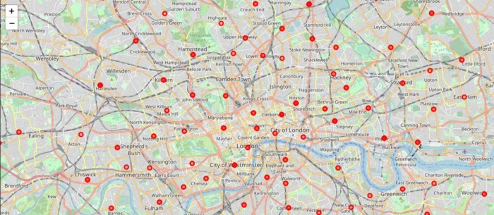

Slide 41
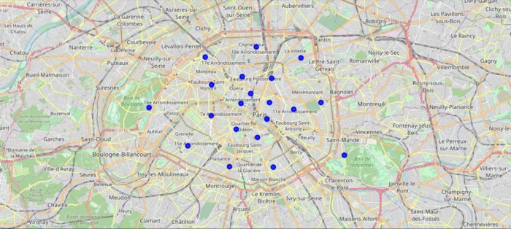

Slide 42
Now that we have visualized the neighbourhoods, we need to find out what each neighbourhood is like and what are the common venue and venue categories within a 500 m radius.
This is where Foursquare comes into play. With the help of Foursquare we define a function which collects information pertaining to each neighbourhood including that of the name of the neighbourhood, Geo-coordinates, venue and venue categories.

Slide 43
LIMIT=100 def getNearbyVenues(names, latitudes, longitudes, radius=500): venues_list=[] for name, lat, lng in zip(names, latitudes, longitudes): print(name) # create the API request URL url = 'https://api.foursquare.com/v2/venues/explore?&client_id={}&client_secret={}&v={}&ll={},{}&radius={}&limit={}'.format( CLIENT_ID, CLIENT_SECRET, VERSION, lat, lng, radius, LIMIT ) # make the GET request results = requests.get(url).json()["response"]['groups'][0]['items'] # return only relevant information for each nearby venue venues_list.append([( name, lat, lng, v['venue']['name'], v['venue']['categories'][0]['name']) for v in results]) nearby_venues = pd.DataFrame([item for venue_list in venues_list for item in venue_list]) nearby_venues.columns = ['Neighbourhood', 'Neighbourhood Latitude', 'Neighbourhood Longitude', 'Venue', 'Venue Category'] return(nearby_venues)

Slide 44
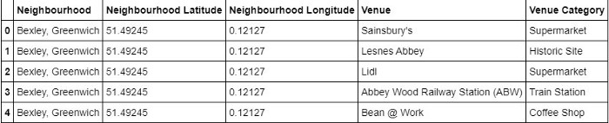

Slide 45
One Hot Encoding
Since we are trying to find out what are the different kinds of venue categories present in each neighbourhood and then calculate the top 10 common venues to base our similarity on, we use the One Hot Encoding to work with our categorical data type of the venue categories. This helps to convert the categorical data into numeric data.
We won’t be using label encoding in this situation since label encoding might cause our machine learning model to have a bias or a sort of ranking which we are trying to avoid by using One Hot Encoding.
We perform one-hot encoding and then calculate the mean of the grouped venue categories for each of the neighbourhoods.

Slide 46
# One hot encoding London_venue_cat = pd.get_dummies(venues_in_London[['Venue Category']], prefix="", prefix_sep="") # Adding neighbourhood to the mix London_venue_cat['Neighbourhood'] = venues_in_London['Neighbourhood'] # moving neighborhood column to the first column fixed_columns = [London_venue_cat.columns[-1]] + list(London_venue_cat.columns[:-1]) London_venue_cat = London_venue_cat[fixed_columns] # Grouping and calculating the mean London_grouped = London_venue_cat.groupby('Neighbourhood').mean().reset_index()

Slide 47
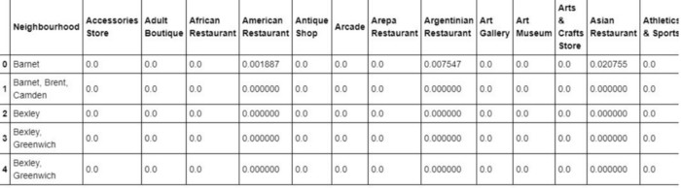

Slide 48
Top Venues in the Neighborhoods
In our next step, We need to sort, rank and label the top venue categories in our neighbourhood.
Let’s define a function to get the top venue categories in the neighbourhood
def return_most_common_venues(row, num_top_venues): row_categories = row.iloc[1:] row_categories_sorted = row_categories.sort_values(ascending=False) return row_categories_sorted.index.values[0:num_top_venues]

Slide 49
There are many categories, we will consider the top 10 categories to avoid data skew.
Defining a function to label them accurately
num_top_venues = 10 indicators = ['st', 'nd', 'rd'] # create columns according to number of top venues columns = ['Neighbourhood'] for ind in np.arange(num_top_venues): try: columns.append('{}{} Most Common Venue'.format(ind+1, indicators[ind])) except: columns.append('{}th Most Common Venue'.format(ind+1))

Slide 50
Getting the top venue categories in the neighbourhoods of London
# create a new dataframe for London neighborhoods_venues_sorted_london = pd.DataFrame(columns=columns) neighborhoods_venues_sorted_london['Neighbourhood'] = London_grouped['Neighbourhood'] for ind in np.arange(London_grouped.shape[0]): neighborhoods_venues_sorted_london.iloc[ind, 1:] = return_most_common_venues(London_grouped.iloc[ind, :], num_top_venues) neighborhoods_venues_sorted_london.head()

Slide 51
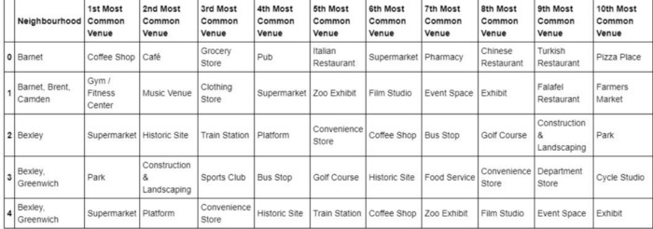

Slide 52
Model Building — K Means
Moving on to the most exciting part — Model Building! We will be using K Means Clustering Machine learning algorithm to cluster similar neighbourhoods together. There are many different cluster sizes that we can select, we will be going with the number of clusters as 5 to keep it as optimized as possible.

Slide 53
# set number of clusters k_num_clusters = 5 London_grouped_clustering = London_grouped.drop('Neighbourhood', 1) # run k-means clustering kmeans_london = KMeans(n_clusters=k_num_clusters, random_state=0).fit(London_grouped_clustering)

Slide 54
Our model has labelled each of the neighbourhoods, we add the label into our dataset.
neighborhoods_venues_sorted_london.insert(0, 'Cluster Labels', kmeans_london.labels_ +1)We then join London_merged dataframe with our neighborhood venues sorted dataframe to add latitude & longitude for each of the neighbourhoods to prepare it for visualization.
london_data = london_merged london_data = london_data.join(neighborhoods_venues_sorted_london.set_index('Neighbourhood'), on='borough') london_data.head()

Slide 55
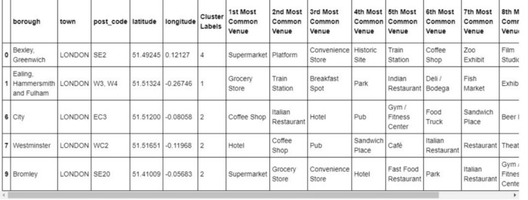

Slide 56
Visualizing the clustered Neighborhoods
Our data is processed, missing data is collected and compiled. The Model is built. All that’s remaining is to see the clustered neighbourhoods on the map. Again, we use Folium package to do so.
We drop all the NaN( Not a Number) values to prevent data skew
london_data_nonan = london_data.dropna(subset=['Cluster Labels'])

Slide 57
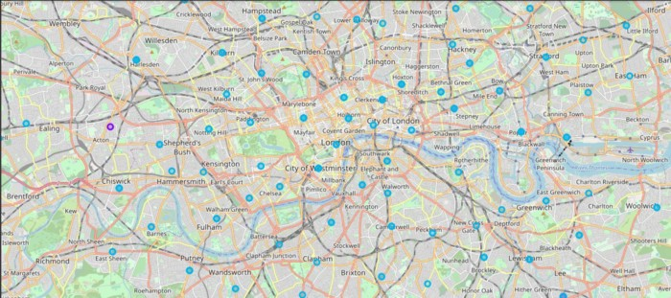
London

Slide 58
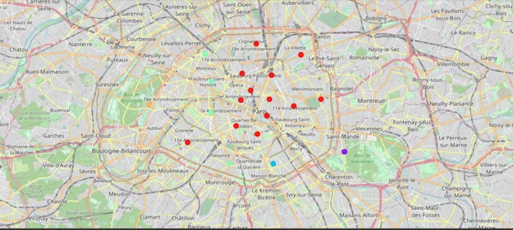
paris

Slide 59
Examining our Clusters
We could examine our clusters by expanding on our code using the Cluster Labels column:
Cluster 1
london_data_nonan.loc[london_data_nonan['Cluster Labels'] == 1, london_data_nonan.columns[[1] + list(range(5, london_data_nonan.shape[1]))]]
Cluster 2
london_data_nonan.loc[london_data_nonan['Cluster Labels'] == 2, london_data_nonan.columns[[1] + list(range(5, london_data_nonan.shape[1]))]]

Slide 60
Cluster 3
london_data_nonan.loc[london_data_nonan['Cluster Labels'] == 3, london_data_nonan.columns[[1] + list(range(5, london_data_nonan.shape[1]))]]
Cluster 4
london_data_nonan.loc[london_data_nonan['Cluster Labels'] == 4, london_data_nonan.columns[[1] + list(range(5, london_data_nonan.shape[1]))]]
Cluster 5
london_data_nonan.loc[london_data_nonan['Cluster Labels'] == 5, london_data_nonan.columns[[1] + list(range(5, london_data_nonan.shape[1]))]]

Slide 61
Results and Discussion
The neighbourhoods of London are very multicultural. There are a lot of different cuisines including Indian, Italian, Turkish and Chinese. London seems to take a step further in this direction by having a lot of restaurants, bars, juice bars, coffee shops, Fish and Chips shop and Breakfast spots. It has a lot of shopping options too with that of the Flea markets, flower shops, fish markets, Fishing stores, clothing stores. The main modes of transport seem to be Buses and trains. For leisure, the neighbourhoods are set up to have lots of parks, golf courses, zoo, gyms and Historic sites. Overall, the city of London offers a multicultural, diverse and certainly entertaining experience.

Slide 62
Paris is relatively small in size geographically. It has a wide variety of cuisines and eateries including French, Thai, Cambodian, Asian, Chinese etc. There are a lot of hangout spots including many Restaurants and Bars. Paris has a lot of Bistros. Different means of public transport in Paris which includes buses, bikes, boats or ferries. For leisure and sightseeing, there are a lot of Plazas, Trails, Parks, Historic sites, clothing shops, Art galleries and Museums. Overall, Paris seems like the relaxing vacation spot with a mix of lakes, historic spots and a wide variety of cuisines to try out.

Slide 63
Conclusion
The purpose of this project was to explore the cities of London and Paris and see how attractive it is to potential tourists and migrants. We explored both the cities based on their postal codes and then extrapolated the common venues present in each of the neighbourhoods finally concluding with clustering similar neighbourhoods together.
We could see that each of the neighbourhoods in both the cities have a wide variety of experiences to offer which is unique in its own way. The cultural diversity is quite evident which also gives the feeling of a sense of inclusion.
Both Paris and London seem to offer a vacation stay or a romantic getaway with a lot of places to explore, beautiful landscapes, amazing food and a wide variety of culture. Overall, it’s up-to-the stakeholders to decide which experience they would prefer more and which would more to their liking.
The detailed code is available on GitHub. Thanks for reading!

Slide 64
References
The Battle of Neighbourhood — My London’s Perspective by Dayo John
The Battle of neighborhoods! What is the best place where can I start my restaurant business in Paris? by Zakaria BOUZIANE
Foursquare API
ArcGIS API

